Slide 1
Autoregressive Models
By Arthur SATOUF

Slide 2
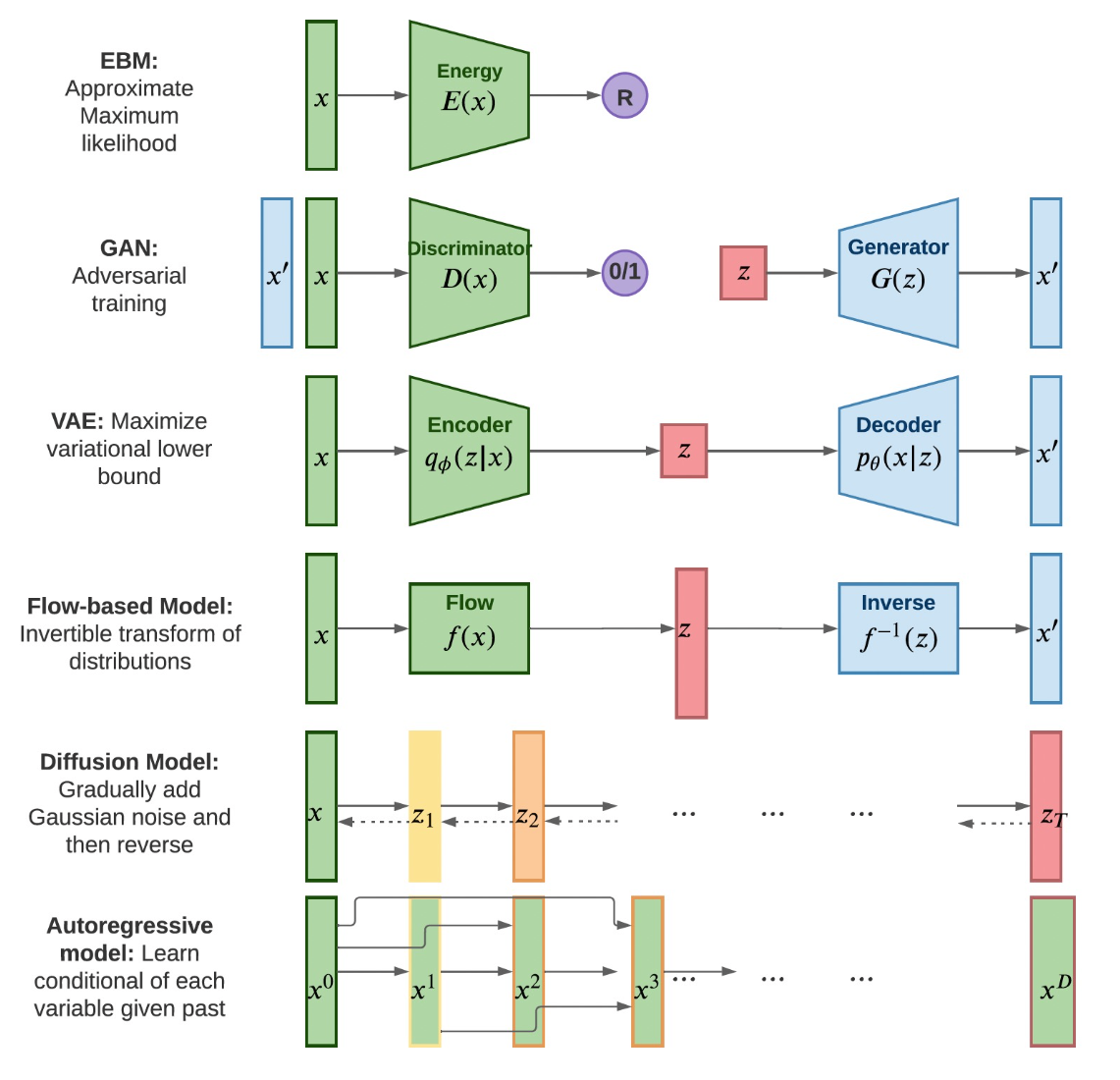
Today

Slide 3
Generative models - how to represent p(x)
Three important concepts to represent p(x) :
Chain Rule : Fully General, no assumption needed
Markov chain/Bayes net: Assumes conditional independencies
Neural Models: Assume specific functional form for the conditionals. A sufficiently deep neural net can approximate any function.
Notes:
we aim to model the joint distribution p(x) using conditional distributions.

Slide 4
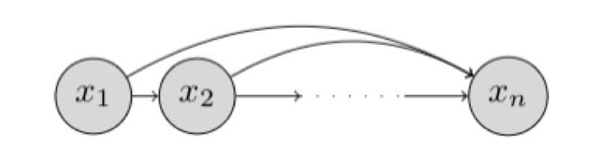
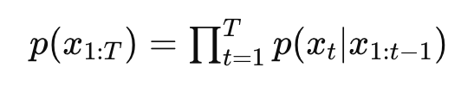
Autoregressive (AR) Models
“Auto” means "self," and “regressive” means "predicting backward
They predict future data points based on previous ones. They generate data sequentially, where each new data point depends explicitly on the previously generated points.
AR models generate data sequentially: each output 𝑥𝑡​ depends explicitly on previously generated values 𝑥1:𝑡−1 ​ .
This factorization simplifies modeling complex, joint distributions into manageable conditional probabilities.

Slide 5
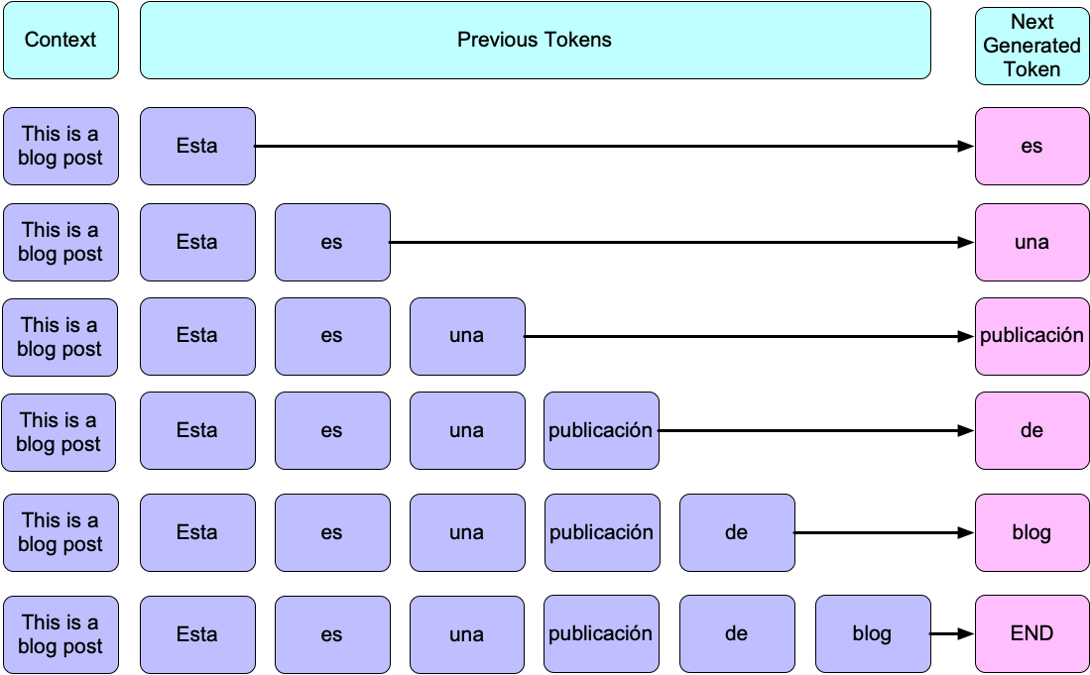
Applications of AR Models
Text Generation: Predict the next word or character in language modeling tasks.
Example:
GPT models for writing text
chatbots
summarization
https://iclr-blog-track.github.io/public/images/2022-03-25-text-gen-via-lfd/text-gen-diagram.png

Slide 6
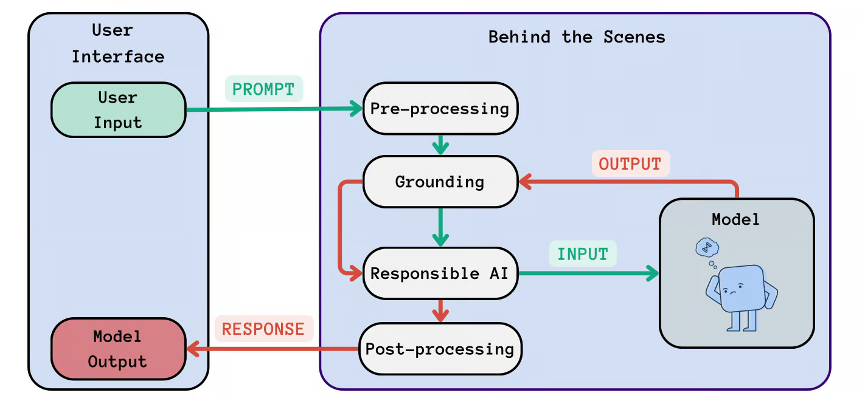
Applications of AR Models - LLMs
https://www.datacamp.com/blog/llmops-essentials-guide-to-operationalizing-large-language-models
Notes:
contextualizing the prompt based on previous conversation turns or external knowledge sources to ensure that the model’s response is coherent and contextually appropriate.

Slide 7
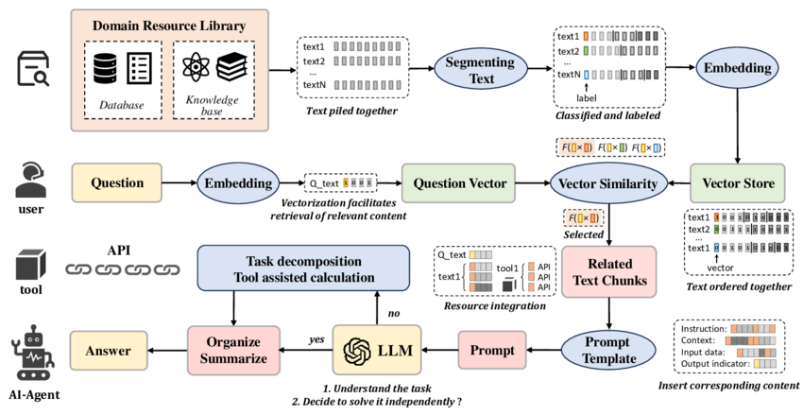
Applications of AR Models - LLMs - RAG

Slide 8
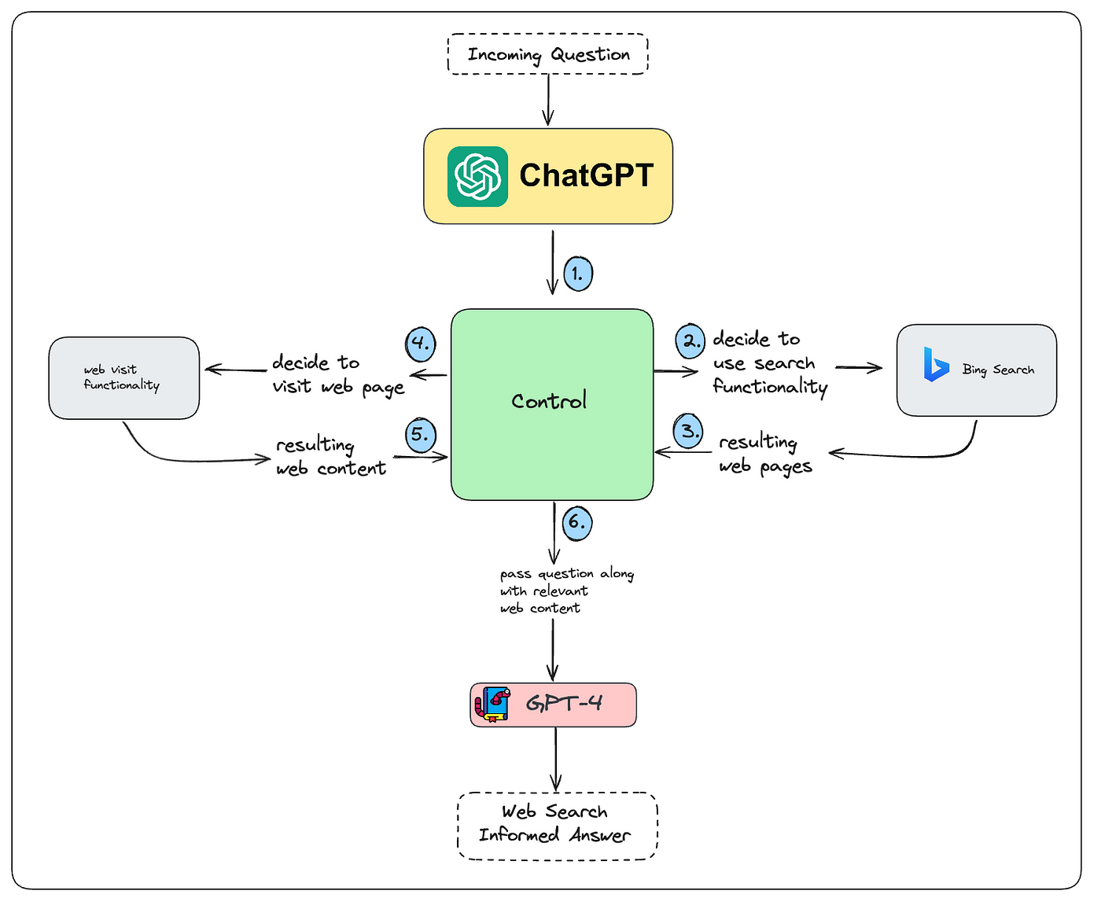
Applications of AR Models - LLMs - RAG
How LLMs access real-time data from the web

Slide 9
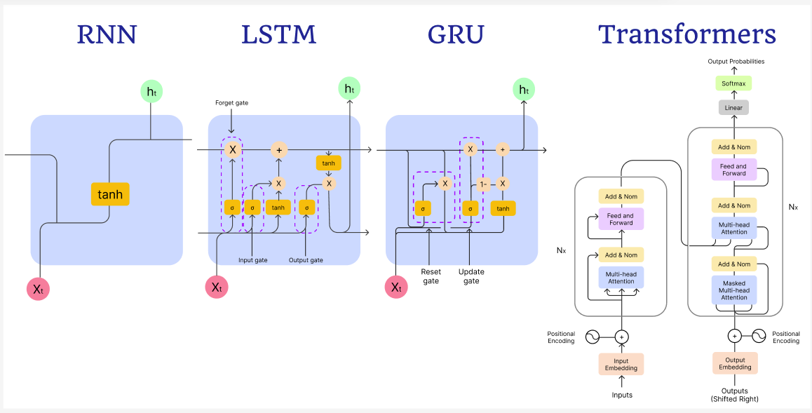
Autoregressive Architectures
RNN-based Models
Vanilla RNN: Simple, sequential modeling using recurrent connections.
LSTM: Enhanced RNN, tackling vanishing gradient issues by gates controlling information flow.
GRU: Simplified LSTM variant with fewer gates, faster to train.
Attention and Transformer-based Models
Self-Attention (Intuition): Allows each data point to directly attend to relevant past points, overcoming RNN limitations.
Transformer Architecture: Based entirely on attention; effectively models long-range dependencies.
GPT Family Overview: From GPT-1 (Decoder-only autoregressive model) to GPT-4 (advanced, large-scale model capable of sophisticated text generation).
https://payload-cms.code-b.dev/media/nks_blog_1.4.png

Slide 10
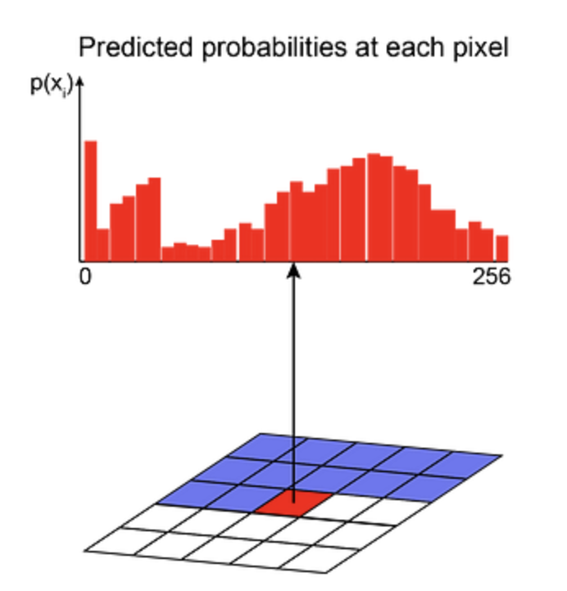
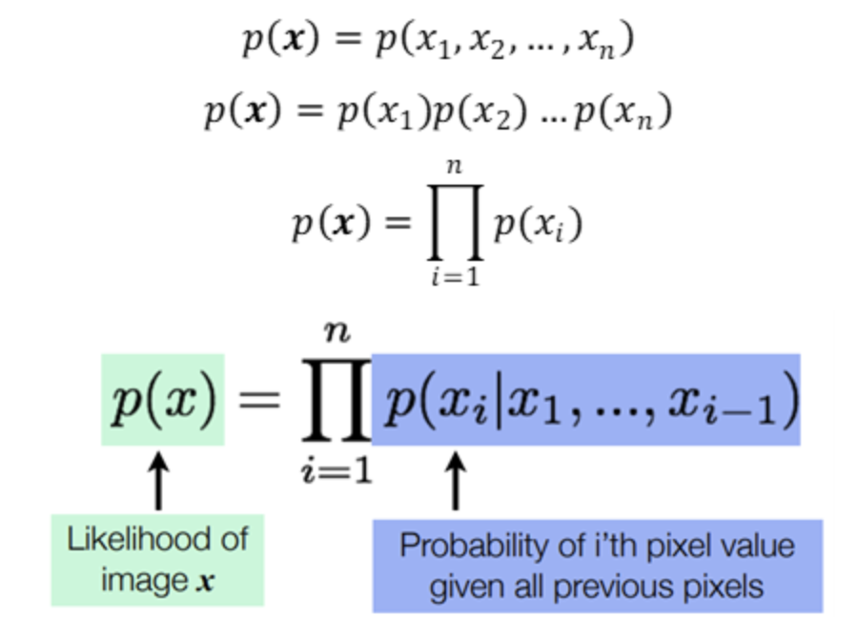
Applications of AR Models
Image Generation: Pixel-level generation, creating images pixel-by-pixel.
Example architecture
PixelCNN
Fast PixelCNN++
PixelSNAIL
VQ-VAE 2

Slide 11
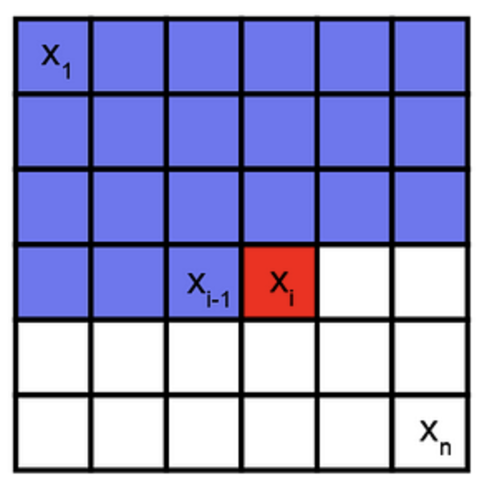
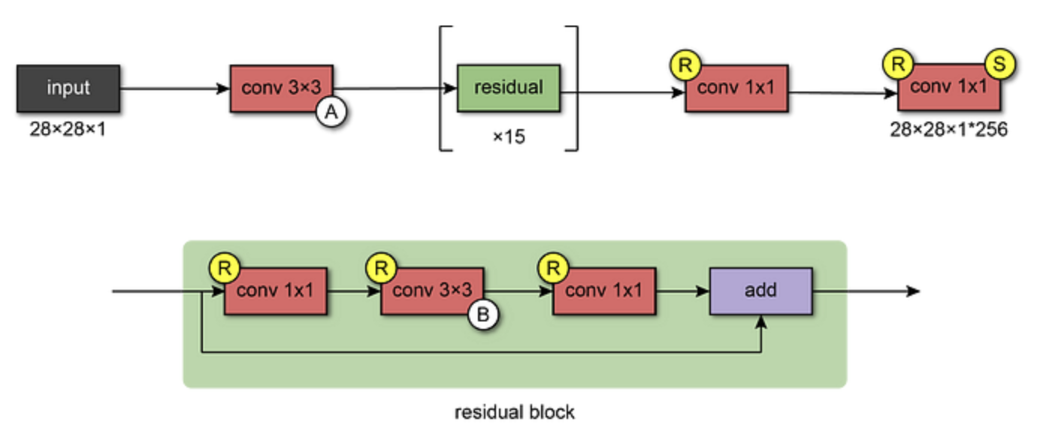
AR Models - PixelCNN
It captures the distribution of dependencies between pixels in its parameters. It sequentially generates one pixel at a time in an image along the two spatial dimensions.

Slide 12
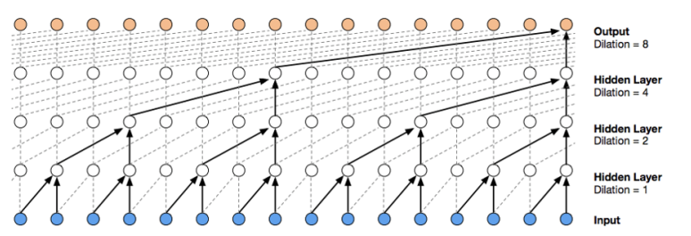
Applications of AR Models
Speech Synthesis: Sequentially generating audio waveforms for natural-sounding speech.
How it works:
Text normalization: Expanding abbreviations, numbers, symbols into natural speech (e.g., "Dr." → "doctor", "2025" → "two thousand twenty-five").
Text is converted into a sequence of phonemes
The processed text (phoneme sequence) is converted into acoustic features—often a Mel-spectrogram.
Autoregressive models like WaveNet sequentially predict each audio sample based on previously generated samples
Speech waveform is generated sample-by-sample. WaveNet typically operates at around 16,000 samples per second (16 kHz), sequentially producing highly detailed waveforms.

Slide 13
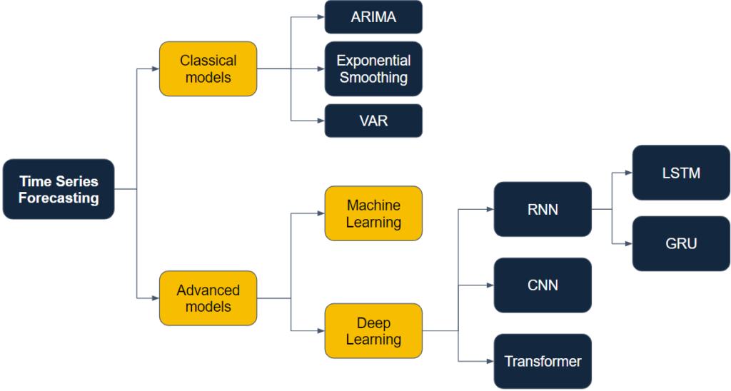
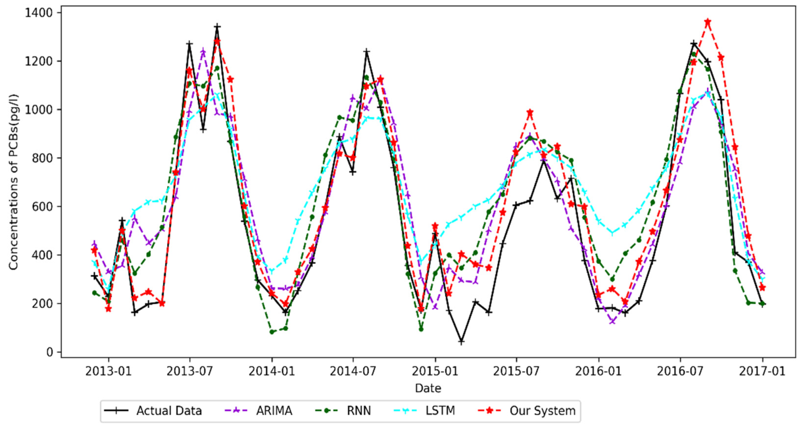
Applications of AR Models
Time Series Prediction: Forecasting future values in finance, weather, and various temporal domains.
https://miro.medium.com/v2/resize:fit:1400/0*kiVbTzHsagNtNGlT.png

Slide 14
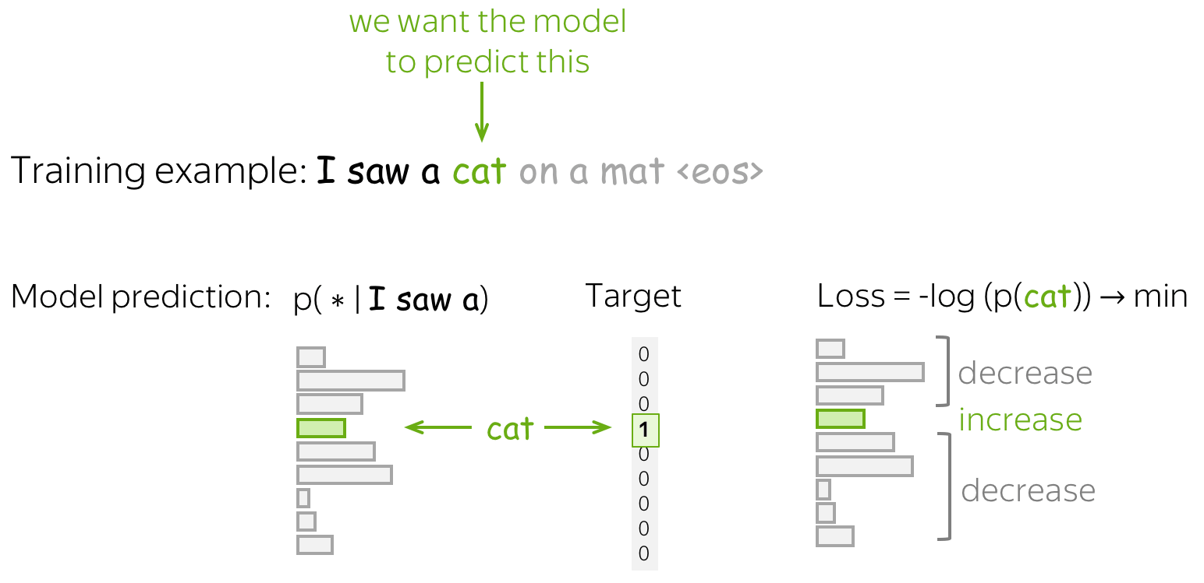
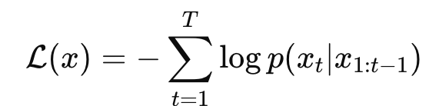
Training Autoregressive
We teach the model to predict the next item in a sequence given previous items.
We maximize the model’s ability to estimate the probability distribution of the data accurately.
Autoregressive models are trained using Maximum Likelihood Estimation (MLE) Cross-Entropy Loss

Slide 15
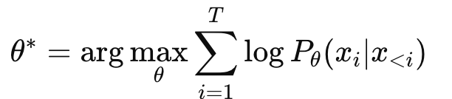
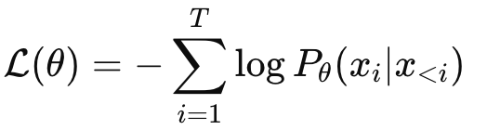
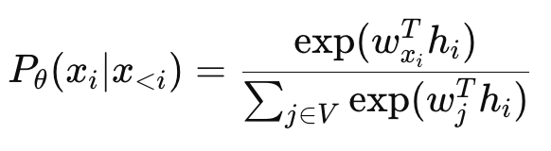
Training Autoregressive - Maximum Likelihood Estimation (MLE)
The model factorizes the joint probability of a sequence xx using the chain rule:
In general, an autoregressive model parameterized by θθ is trained to maximize the likelihood:
where x<i=(x1,...,xi−1) represents the preceding tokens.
The model learns by minimizing the negative log-likelihood (NLL), which is equivalent to maximizing the likelihood:
In practice, since GPT uses a softmax distribution over the vocabulary VV, the probability of token xi given the previous tokens is:
Where : hi​ is the hidden representation x<i (by Transformer)
wj​ are learnable word embeddings for vocabulary token j

